Slide 1
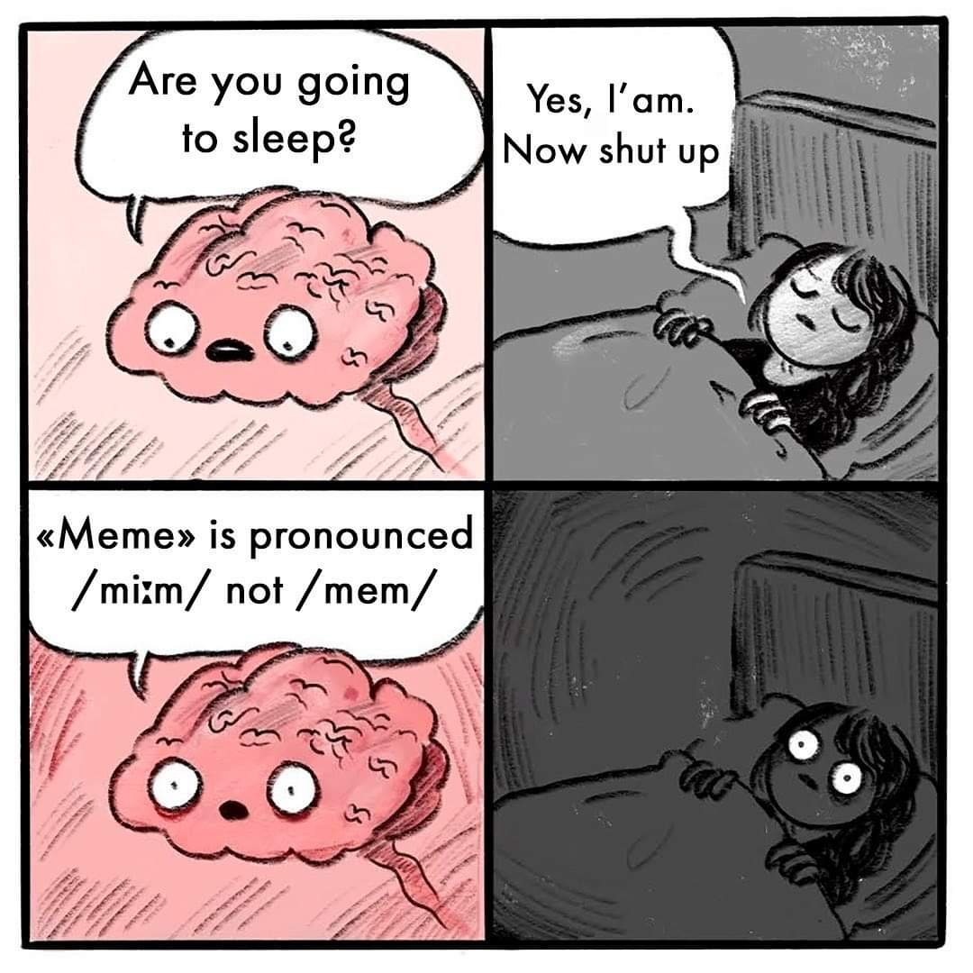
MEME - Making English More Entertaining
29th Annual International HUPE Conference, Poreč
Mirna Kurtović
Ksenija Benčina

Slide 2
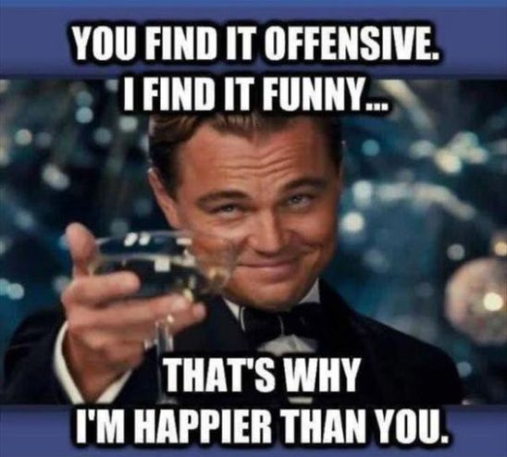
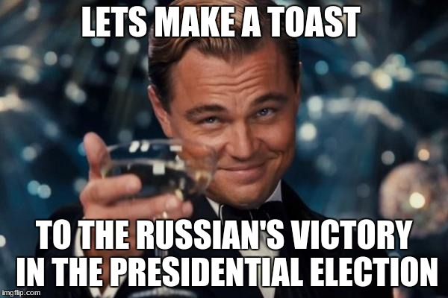
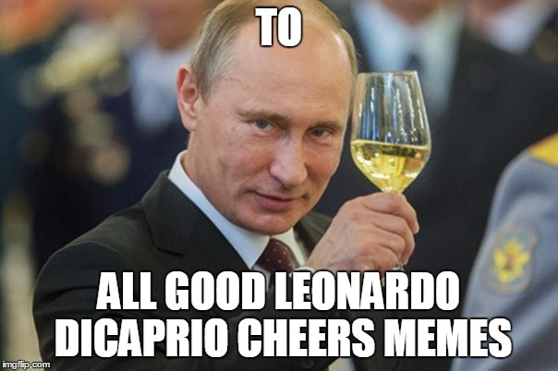
Memes
1. a cultural feature or a type of behaviour that is passed from one generation to another, without the influence of genes
Greek mimēma ‘that which is imitated’, (coined by British evolutionary biologist Richard Dawkins in The Selfish Gene)
2. (internet meme) an idea, image, video, etc. that is spread very quickly on the internet
Notes:
2. humorous, viral, often altered, can be obvius or subtle, often culturally specific, often featuring celebrities

Slide 3
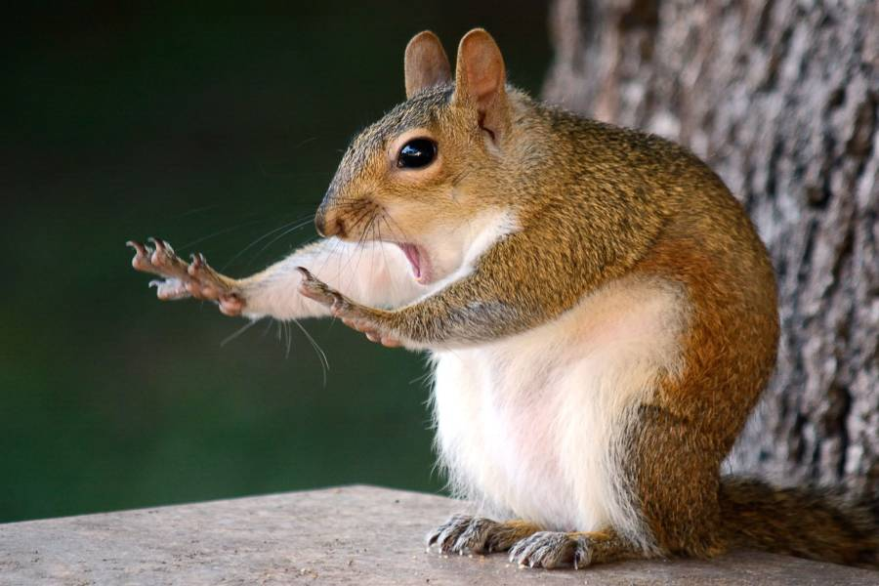
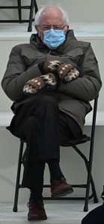
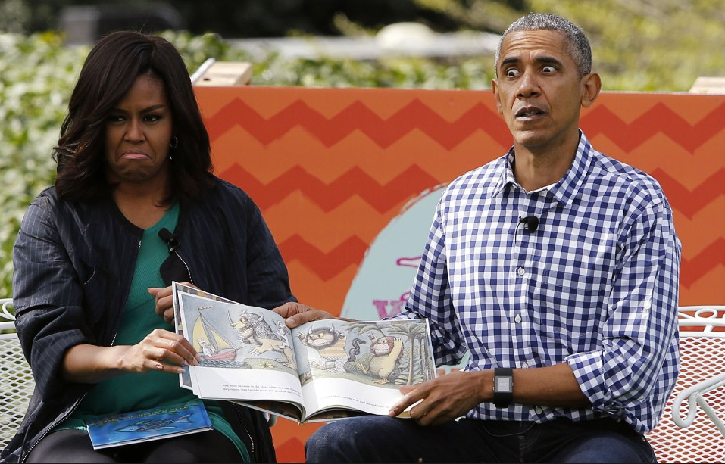
Memes
Memeable
Notes:
Of a photograoh – having the potential to become a meme

Slide 4
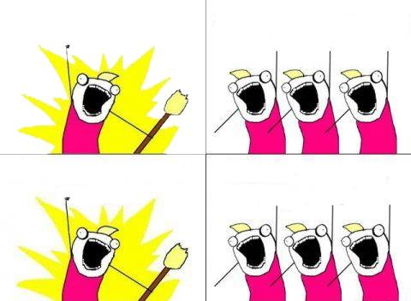
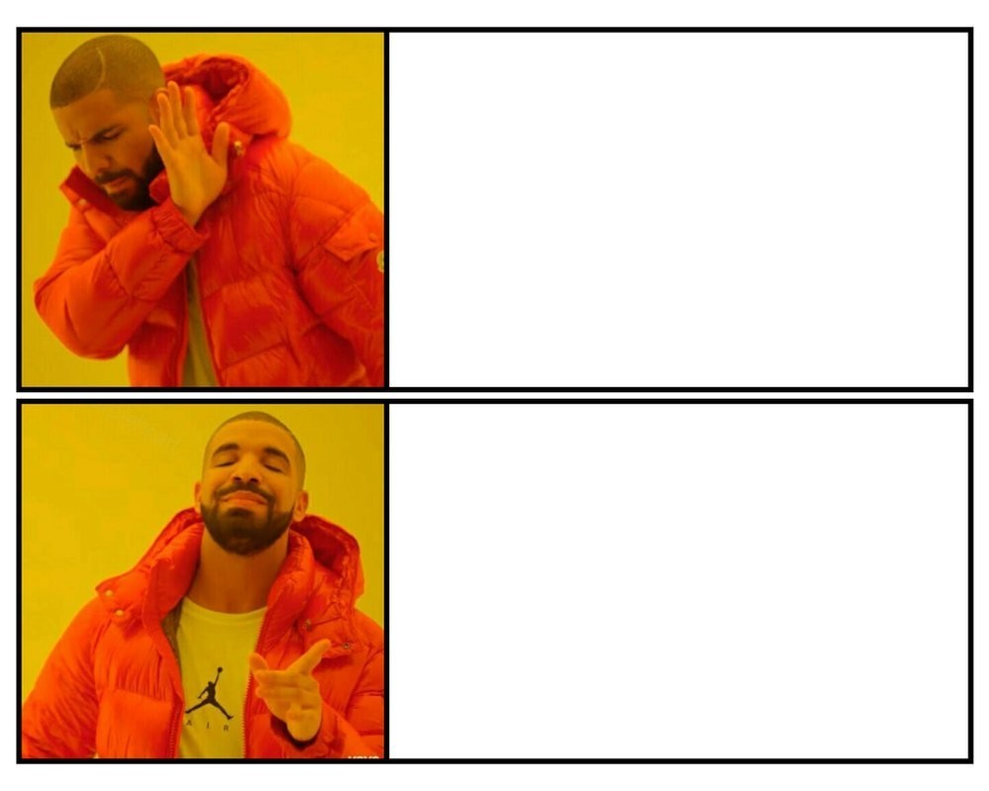
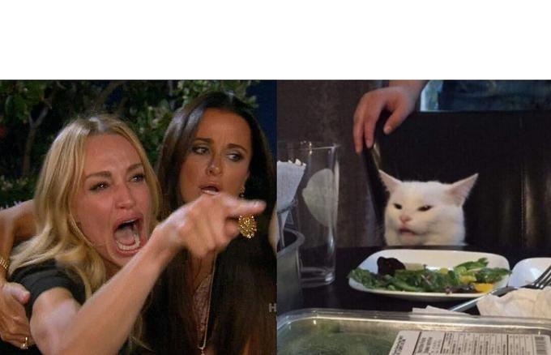
Memes - images and text

Slide 5
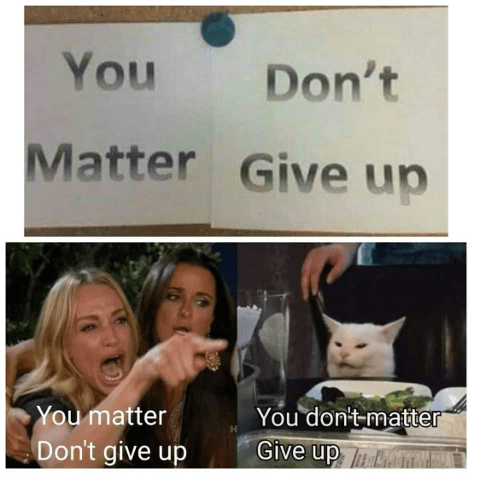
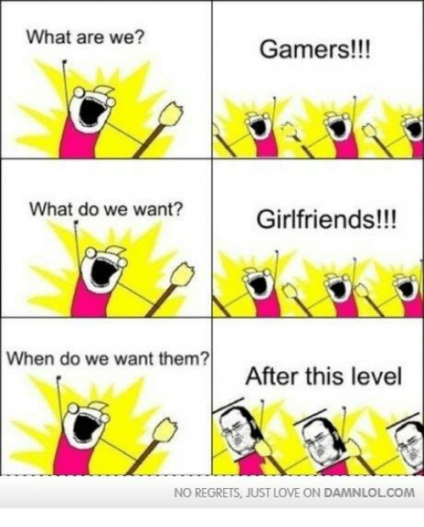
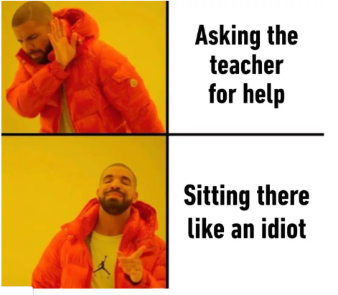
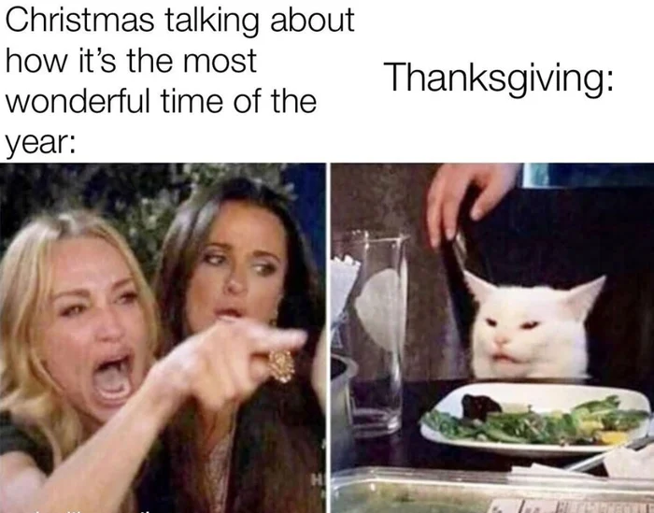
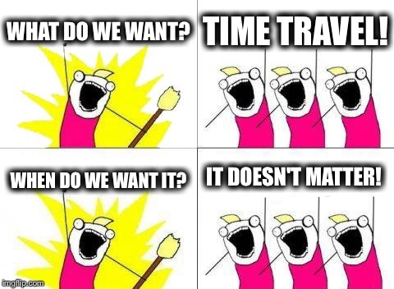
Notes:
Drakeposting” refers to a common meme of using two screen captures from Drake's "Hotline Bling" music video to denote preference of one thing over another. The top image would be of Drake turning his head away from an adjacent image or text with his hand extended as if to reject the image outright. The bottom image would then be Drake looking at another adjacent image or text with a look of satisfaction on his face as he points to it. The implication is that he (or the user posting the overall picture) prefers the bottom thing over the top thing.

Slide 6
Memes – only text
Common openings and sentences:
Shout out to all the…
I don’t know who needs to hear this, but…
When (someone) …
Me trying to…
What I say…/ What (someone) hears…
Literally no one: …. Me / Someone:
(someone) be like…
… Asking for a friend

Slide 7
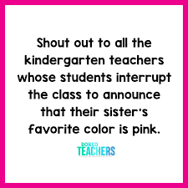
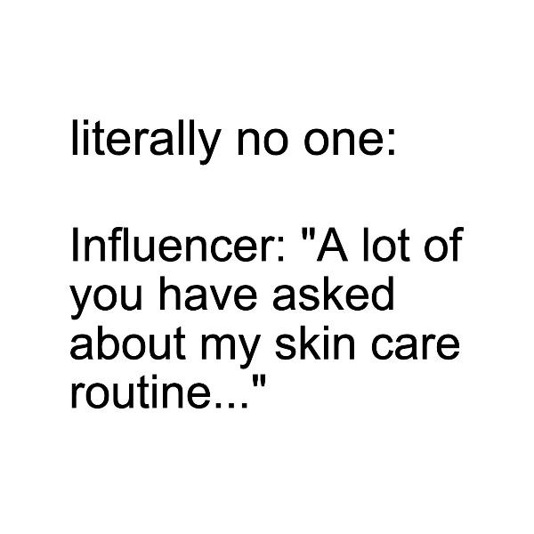
Notes:
"Nobody:", also known as "No One:" Tweets and "Nobody:" Tweets and "Literally No One:", is a phrasal template used to mock people who strive to attract attention and tend to provide unsolicited opinions, as well as for observational humor. The format rose to popularity in Autumn 2018 with tweets usually starting with the phrases "No one:", "Nobody:" and "Me:", continued with text or visual descriptions of an unprovoked action by a certain individual.

Slide 8
Activities
Grammar
Vocabulary
Speaking
Writing
Translation
Searching for additional information

Slide 9
Grammar practice – correcting mistakes

Slide 10
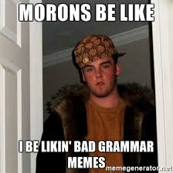
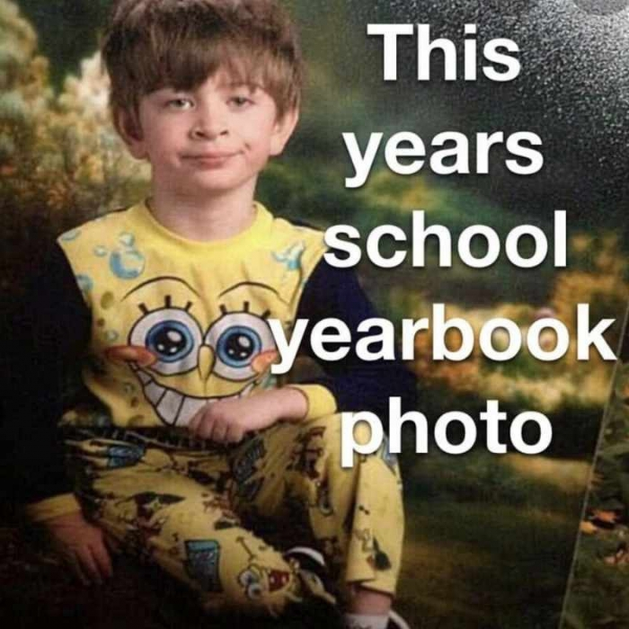
Correcting mistakes

Slide 11
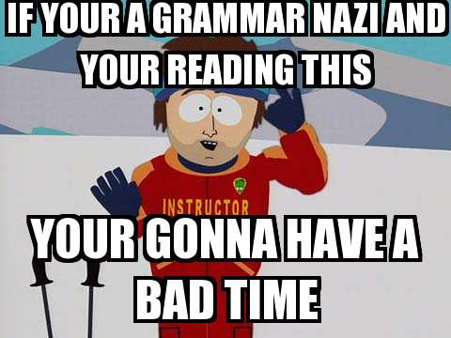
Correcting mistakes

Slide 12
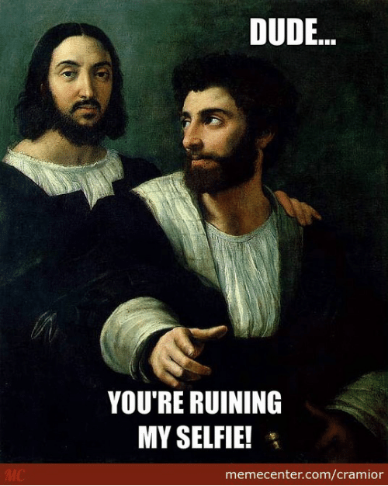
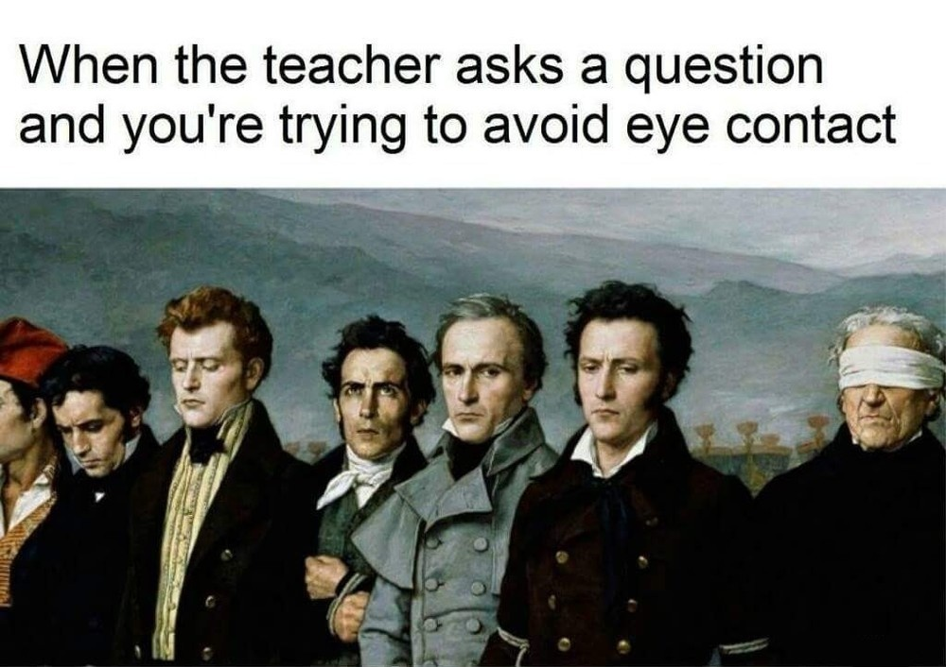
Correlation with other subjects – Art
Notes:
Warm-up activity

Slide 13
Correlation with other subjects – Art

Slide 14
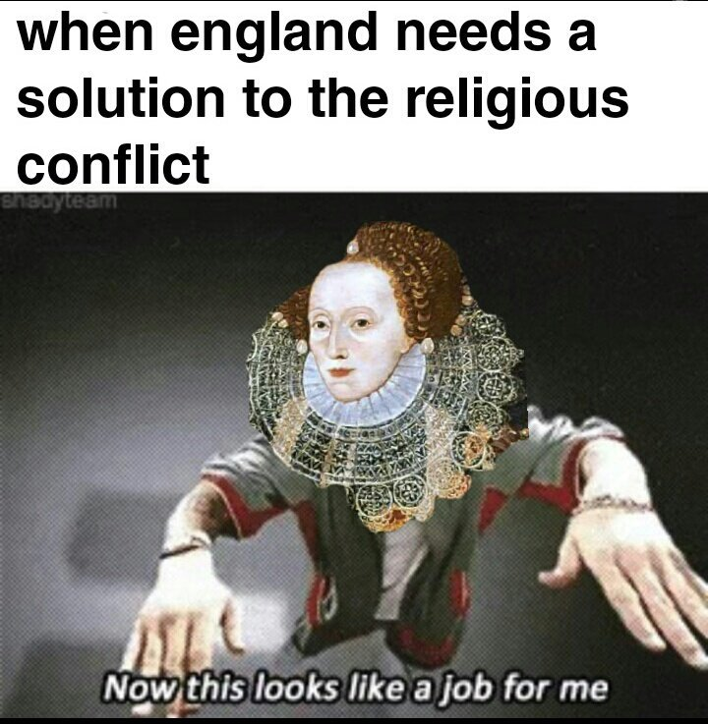
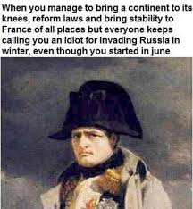
Correlation with other subjects – History
Notes:
Elisabeth I – religious settlement 16th century

Slide 15
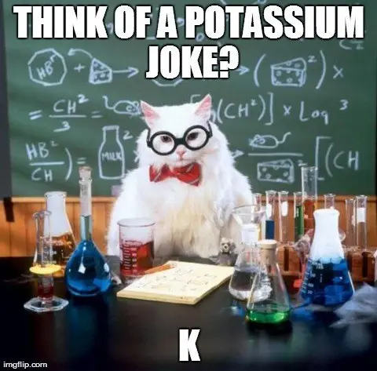
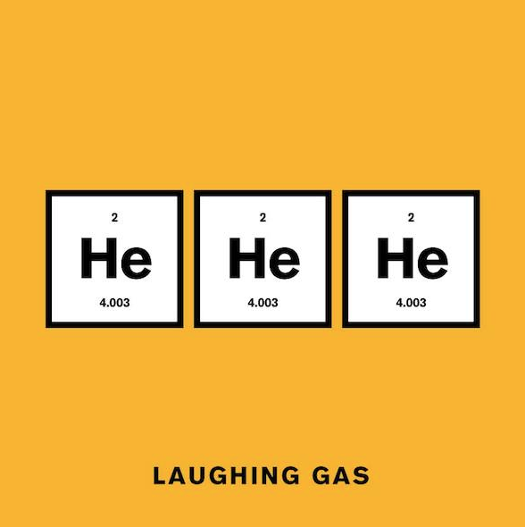
Science

Slide 16
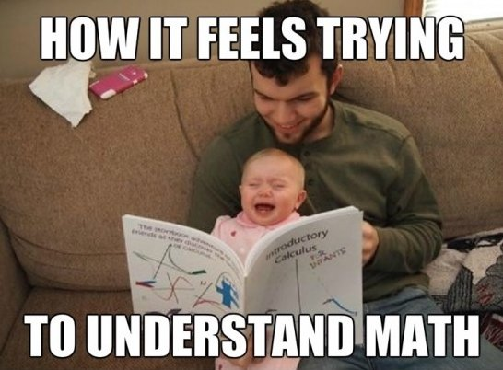
Correlation with other subjects – Mathematics
Notes:
Vocabulary: adding, subtracting, multiplying, division, equasion…

Slide 17
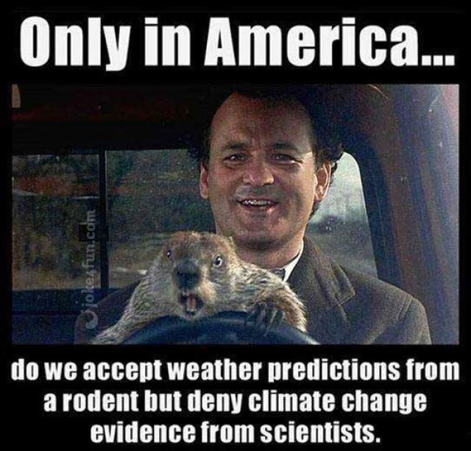
Culture
Notes:
Ksenija

Slide 18
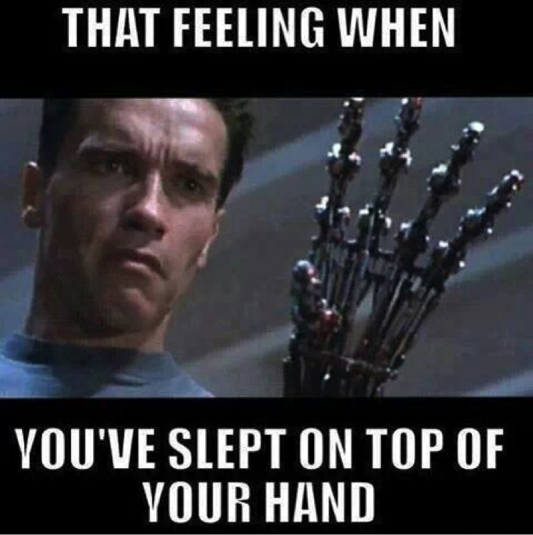
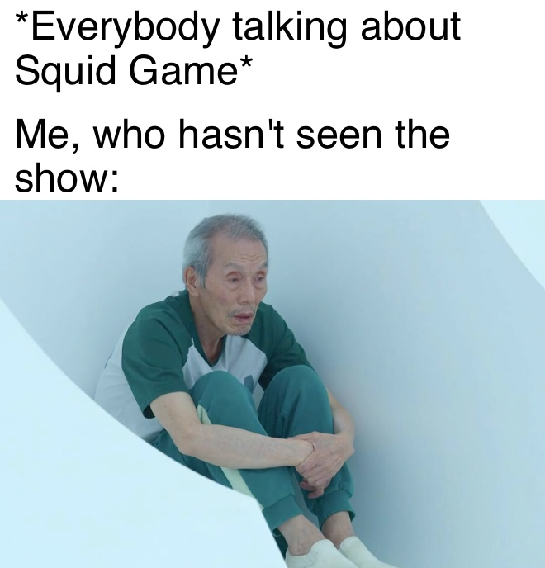
Popular culture – series and films

Slide 19
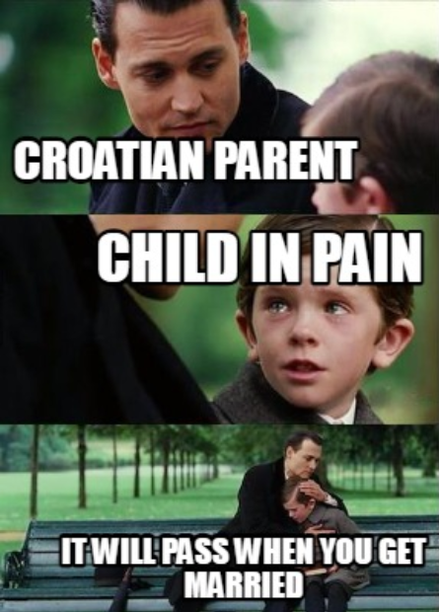
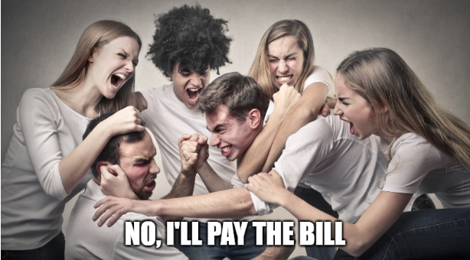
Students’ memes about Croatian culture

Slide 20
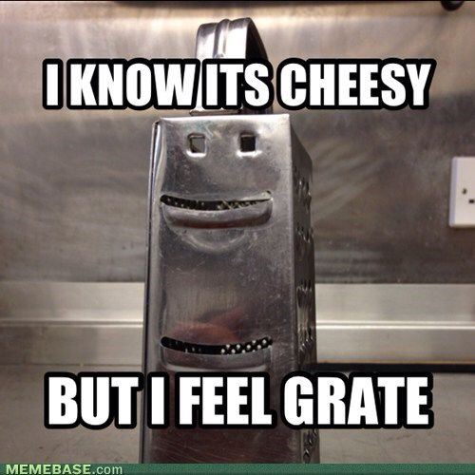
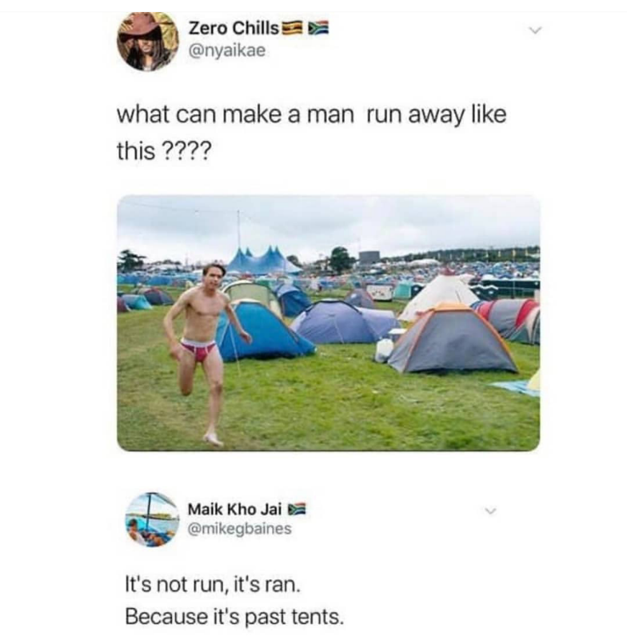
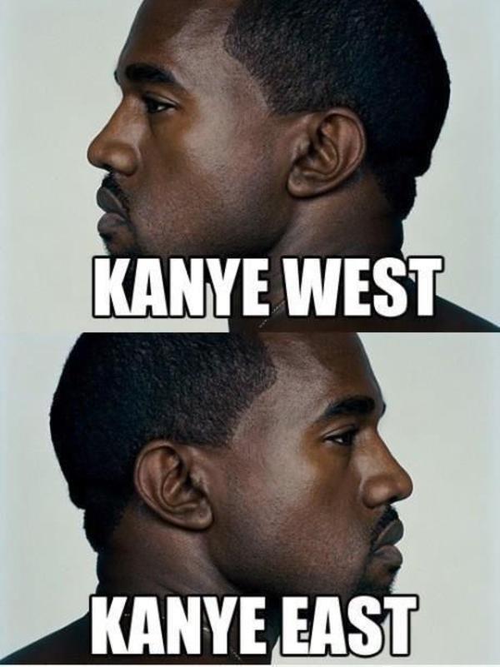
Puns and word play

Slide 21
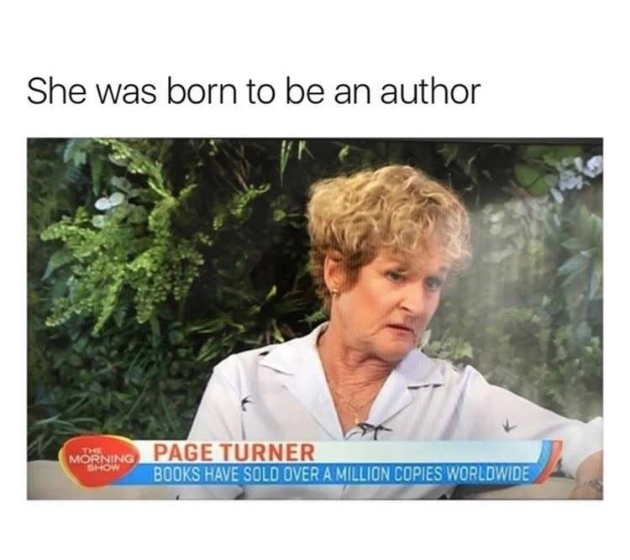
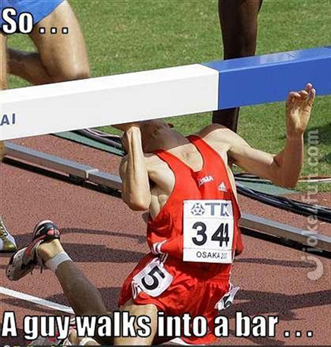
Puns and word play

Slide 22
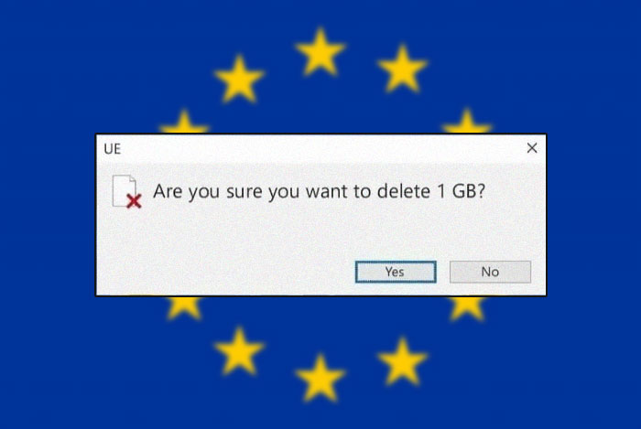
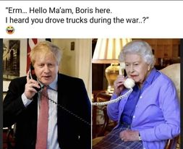
Current events
Notes:
Additional activity – students check the news

Slide 23
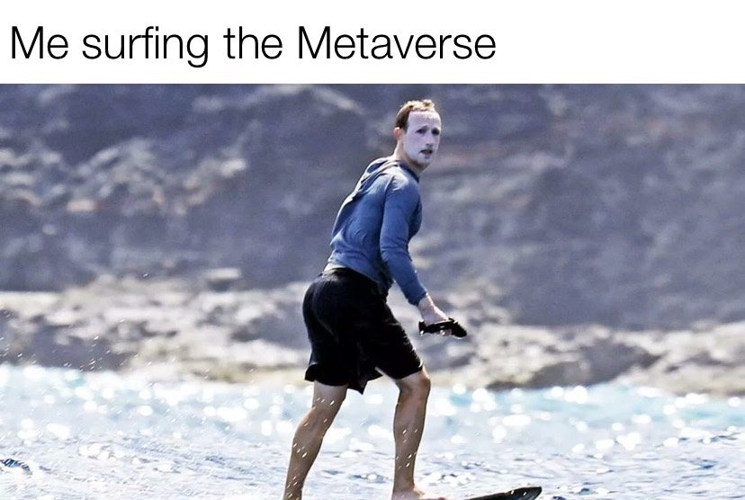
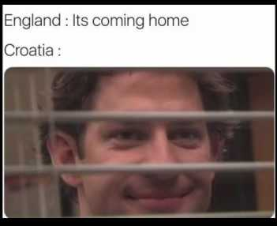
Current events

Slide 24
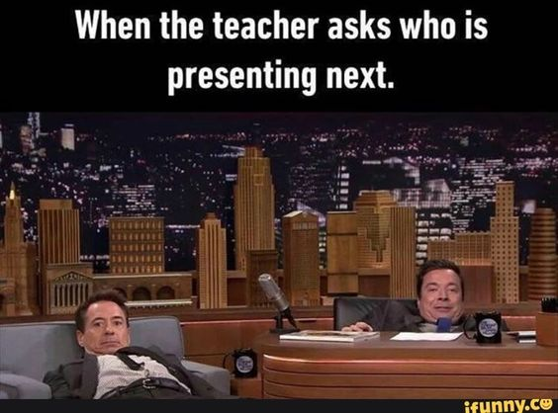
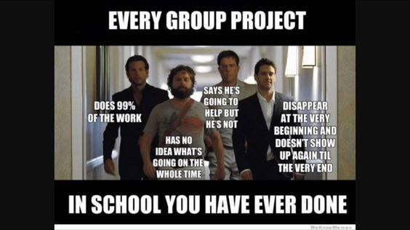
Activities – matching, write a different text

Slide 25
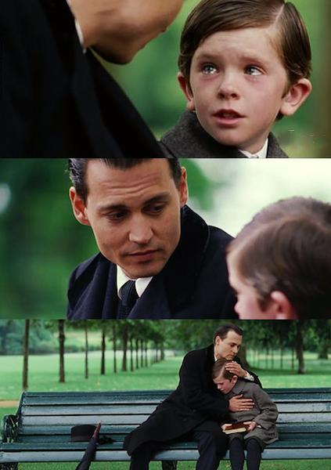
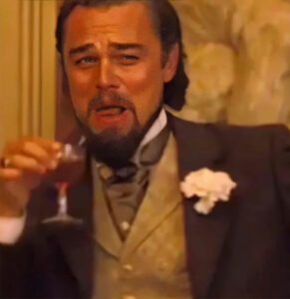
Templates
Notes:
Create a meme- HUPE

Slide 26
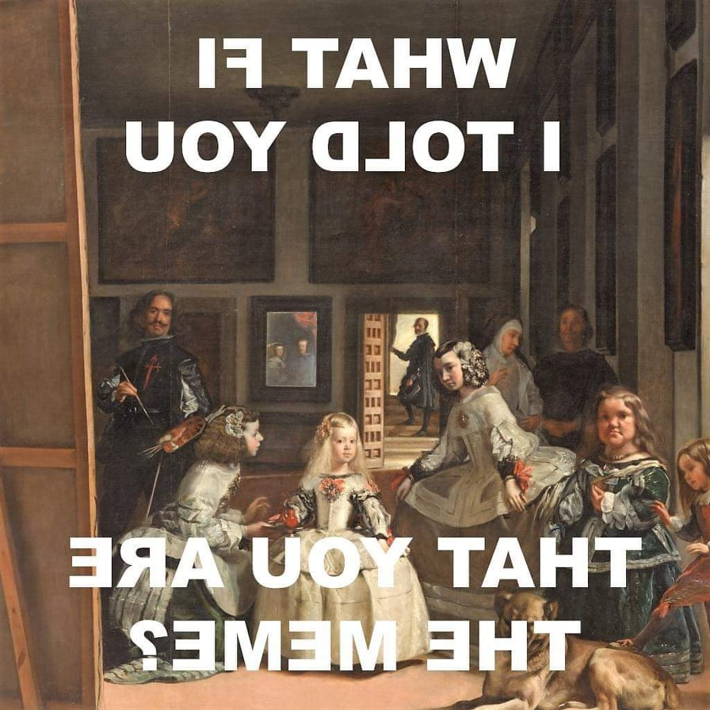

Slide 27
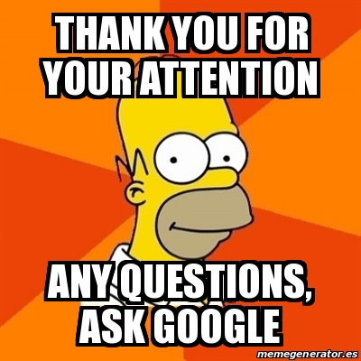
Mirna Kurtović mirna.kurtovic@os.t-com.hr
Ksenija Benčina kbencina@foozos.hr

